Slide 1






Sophie’s story
SECRET
3 Agile strategies for transforming your workplace
25th of April, 2024

Slide 2



Edwige FIACLOU
Creativity
“Continuous learning & passion for technologies. Drive innovation with creativity and open minded!”
About me!
Deputy Head
Tech Talent & Methodologies
Software Engineering

Slide 3


01
02
03
04
Sophie’s Story
Agenda
Make the Invisible visible
Identify your battles
Cultivate continuous Improvement

Slide 4



The Story of Sophie
Team Lead and Project Manager for Financial Trading Applications.
Innovative Approach for new application with algorithm and high-performing technologies.
Sophie’s story

Slide 5



Slide 6








The D-Day for Sophie
8:31
8:32
8:45
9:00
17:30
7:30
8:00
8:30
Sophie’s story

Slide 7

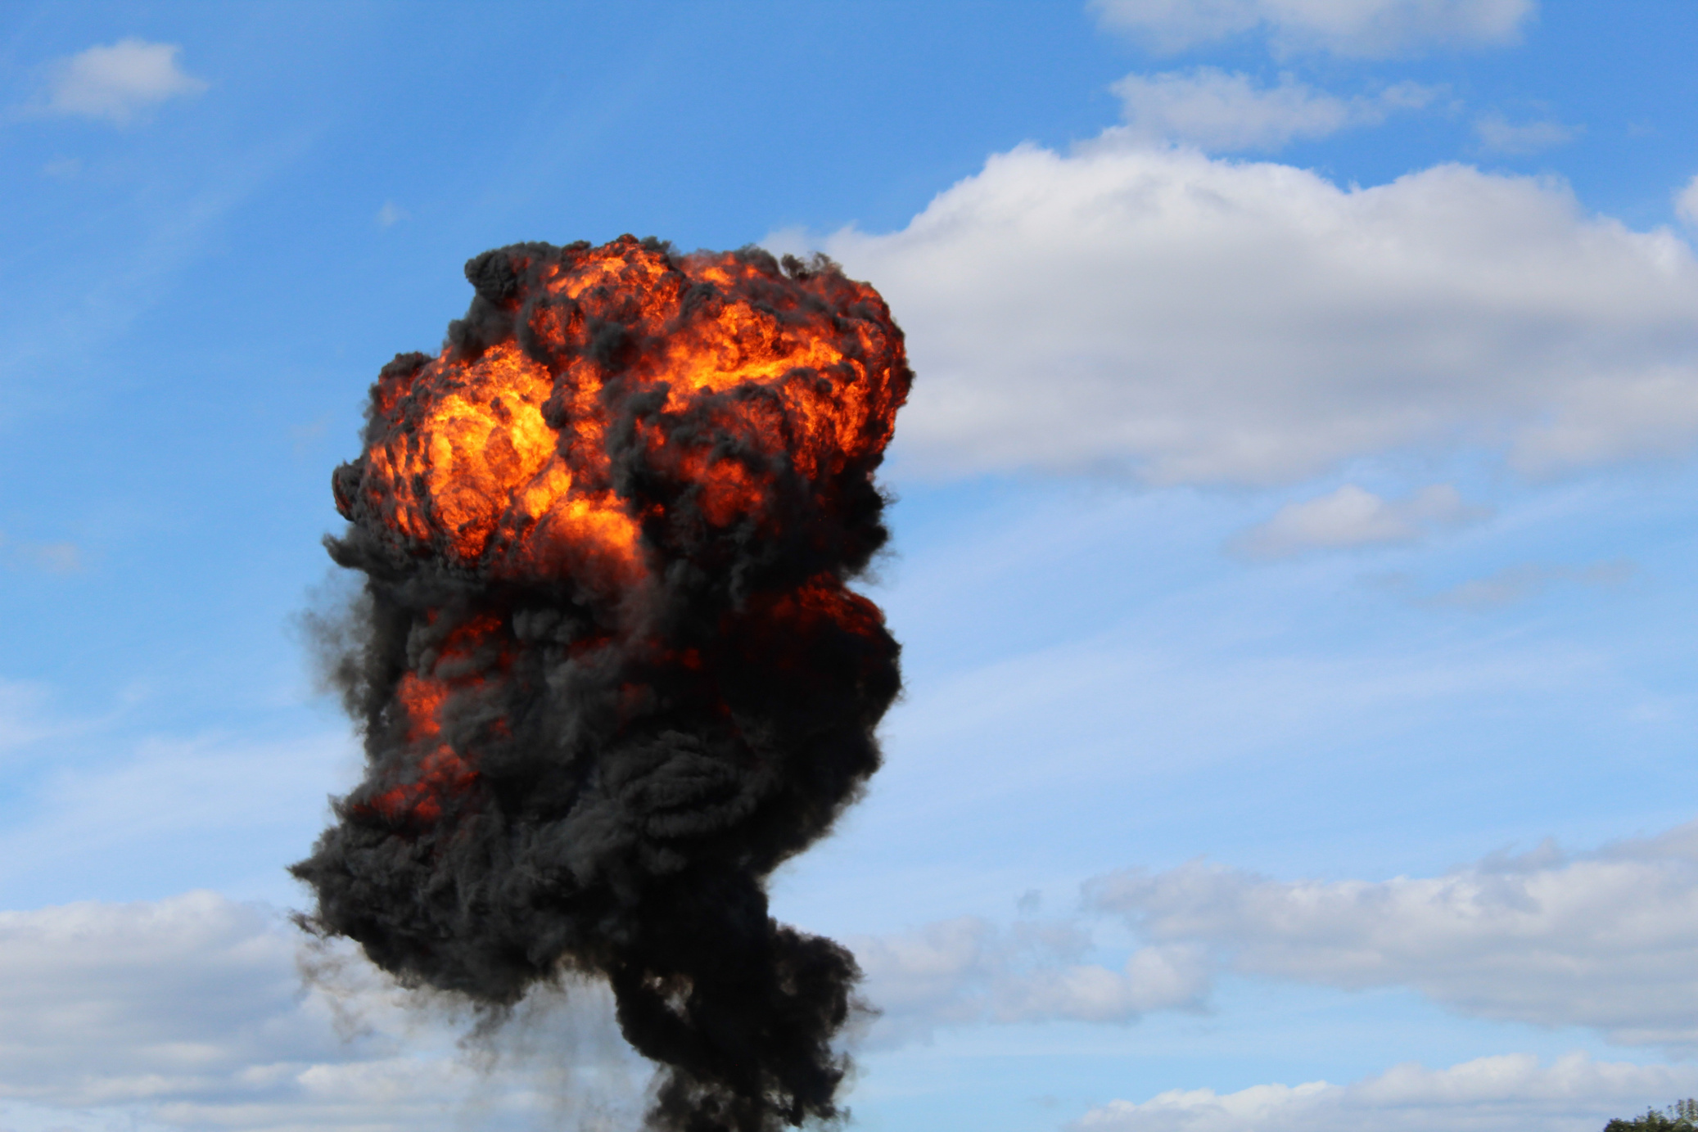

What happened?
Sophie’s story

Slide 8

Post-mortem outcomes
Stakeholder
Unidentified
Unperceived complexity
No knowledge based
Sophie’s story

Slide 9

It’s all about Disciplined Agile!

Slide 10


True business agility comes from freedom, not frameworks.
Freedom
Guidance
What’s Disciplined Agile?

Slide 11
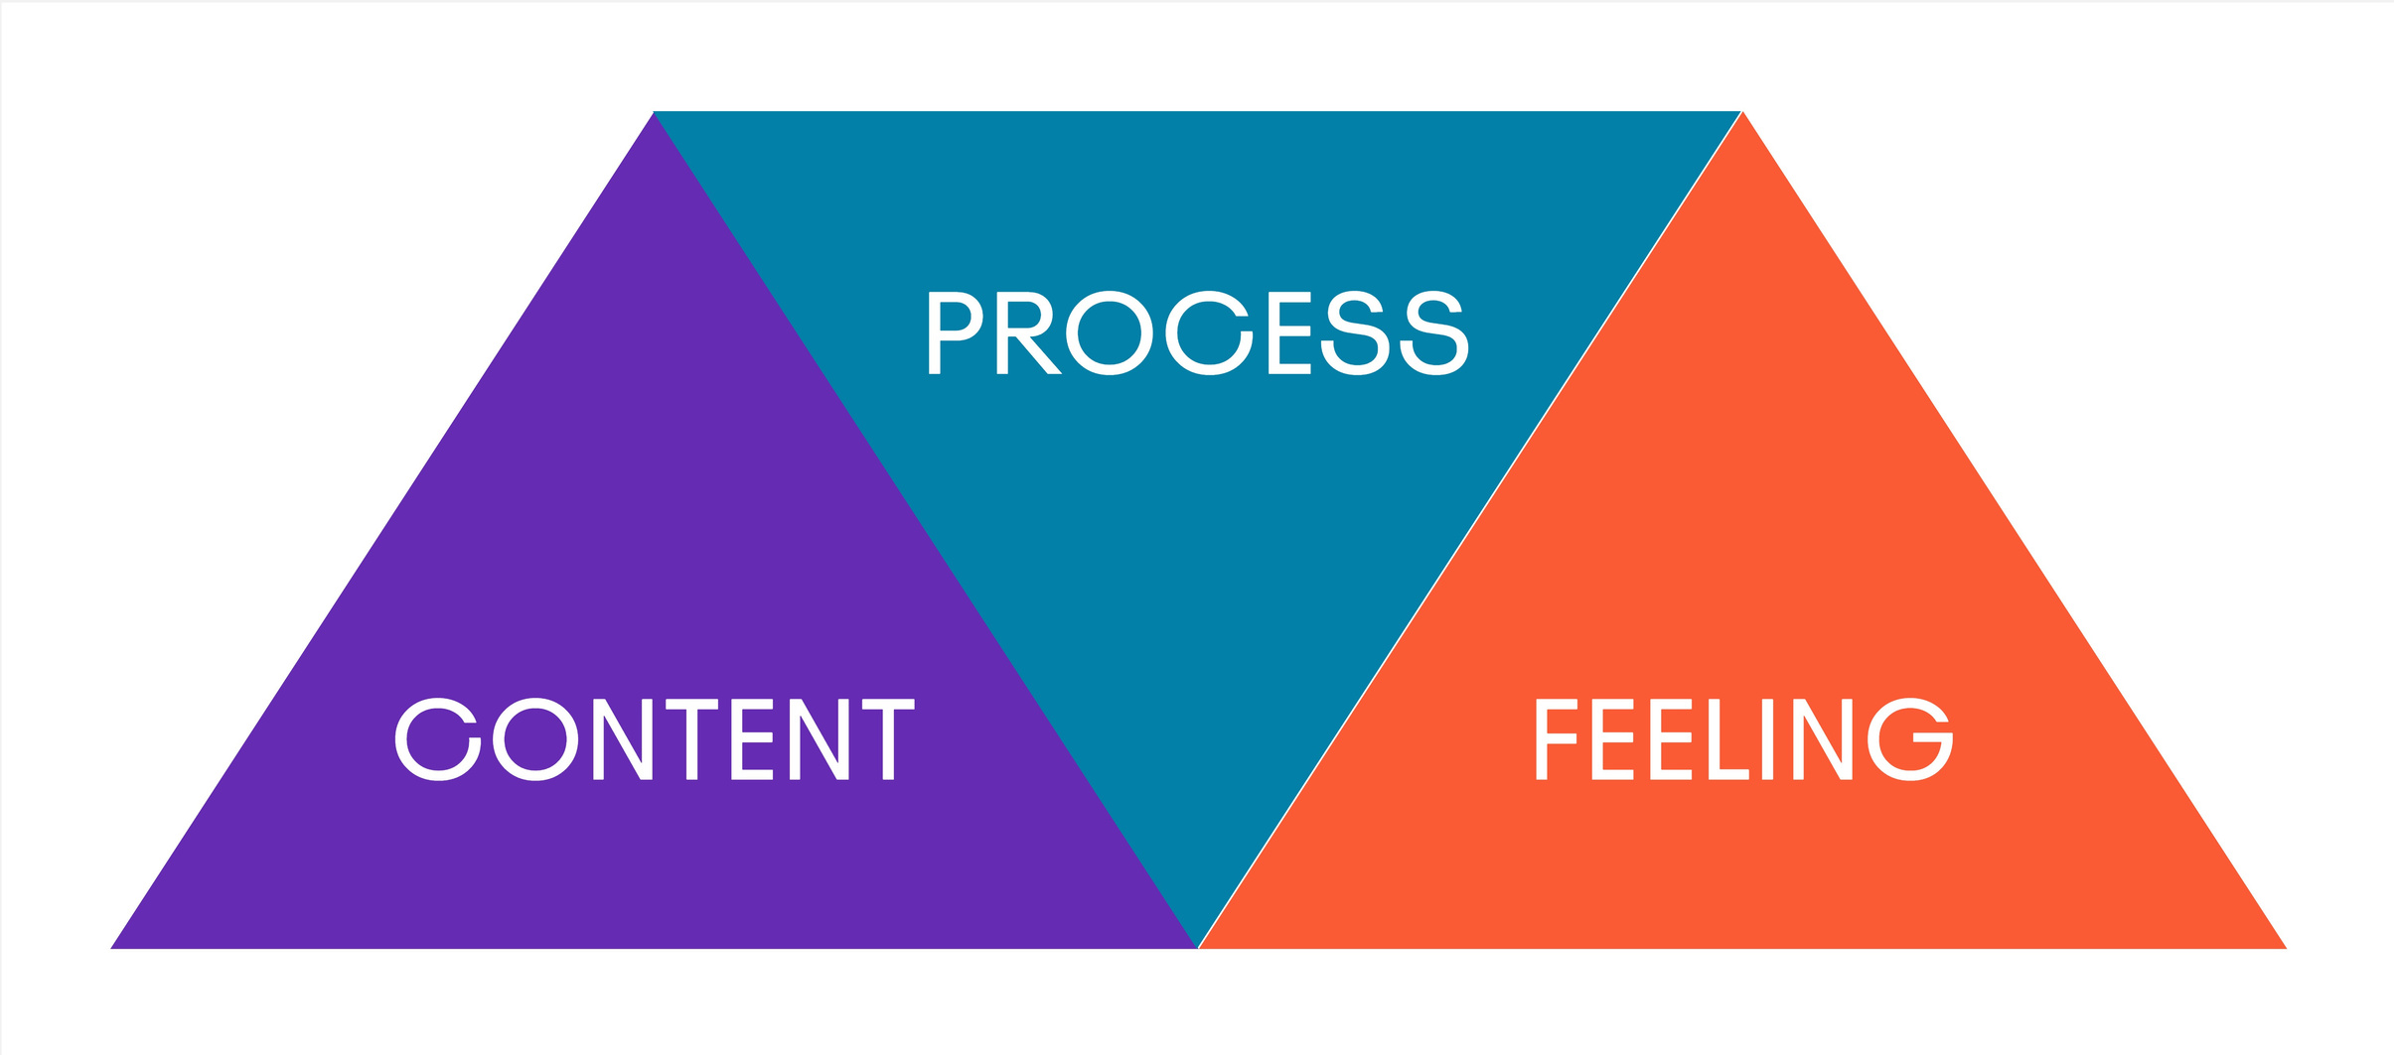
DA Pillars
What’s Disciplined Agile?

Slide 12
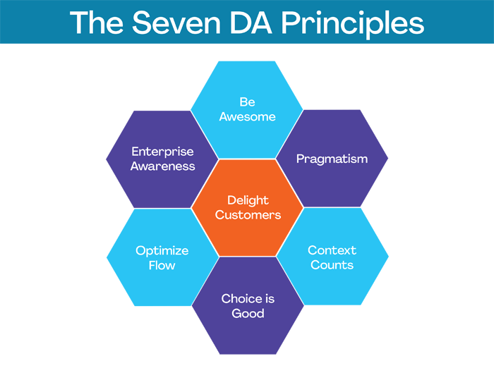

What’s Disciplined Agile?

Slide 13
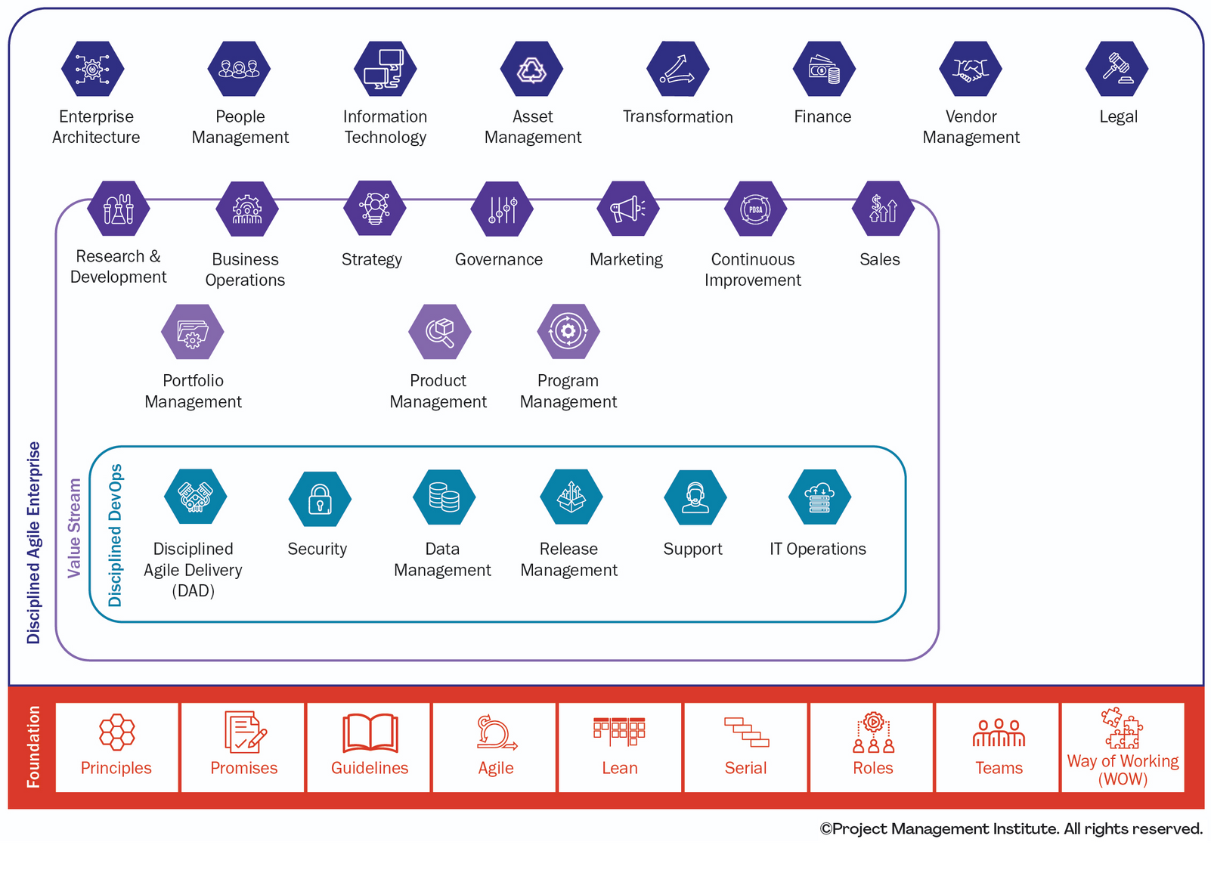
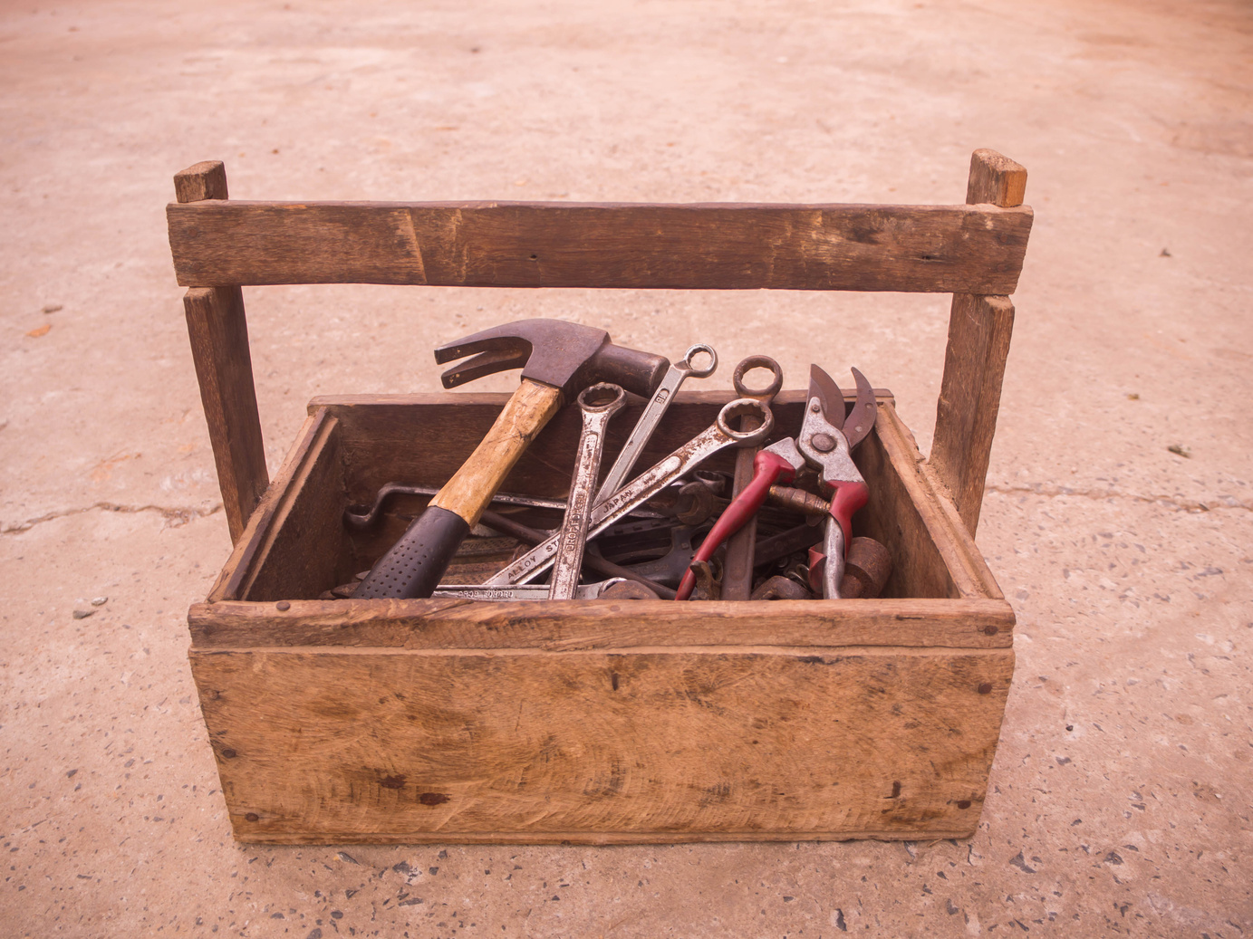
At scale
What’s Disciplined Agile?

Slide 14

Three Strategies
#1
Make the invisible visible
#2
Identify your battles
Cultivate continuous improvement
#3

Slide 15
Presentation guide
1.
Strategy
1.a
Theory
1.a.1
Benefits
2.b
Practical example

Slide 16

Strategy #1
Stakeholder
Unidentified

Slide 17
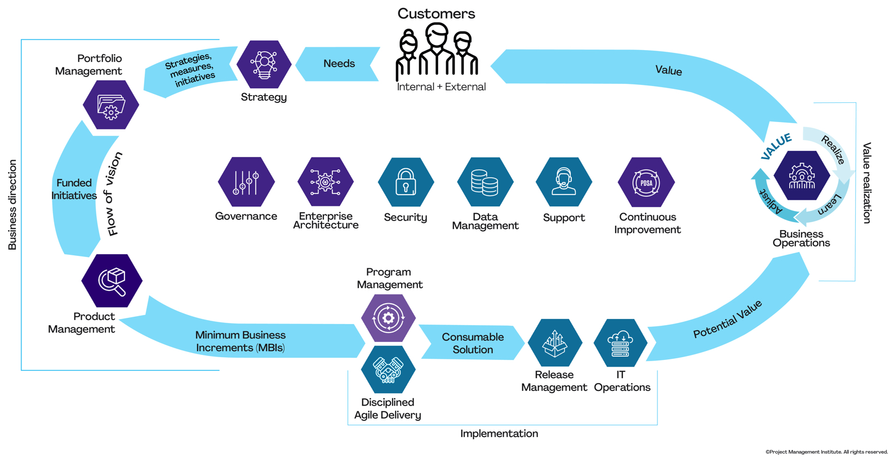
Strategy #1 - Make the invisible visible

Slide 18
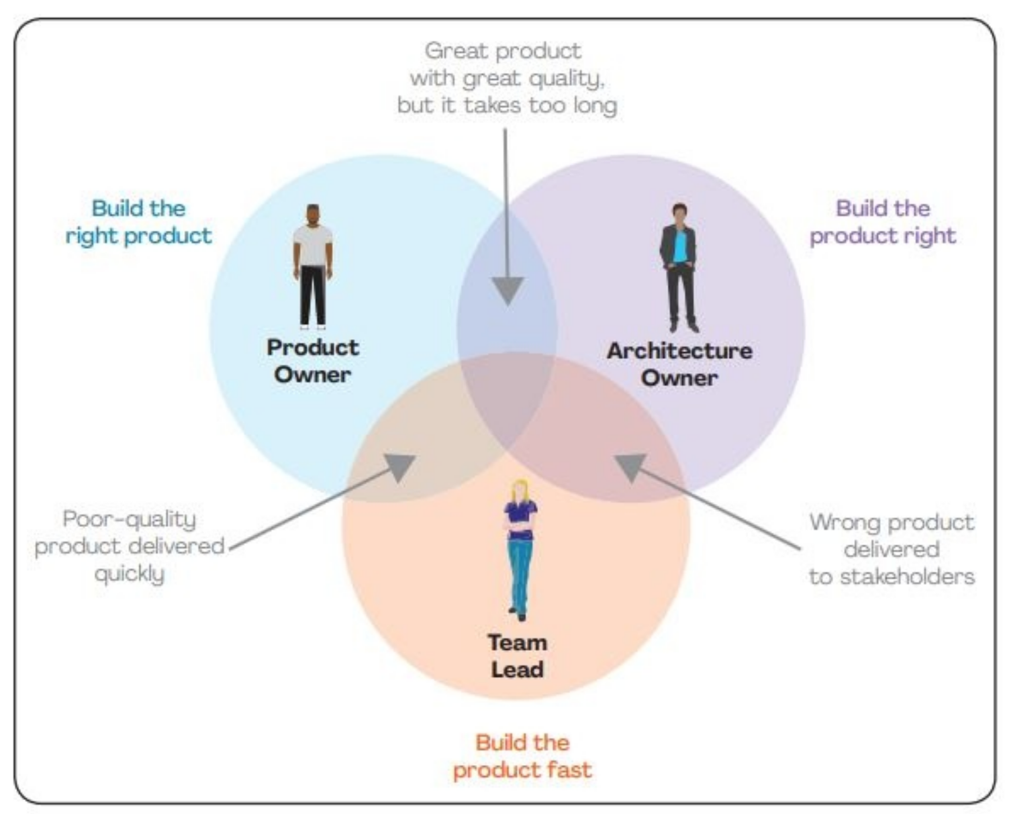
Strategy #1 - Make the invisible visible

Slide 19
Benefits
#1
Flow transparency
#2
Process Awareness
#3
Expertise reliability
Strategy #1 - Make the invisible visible

Slide 20
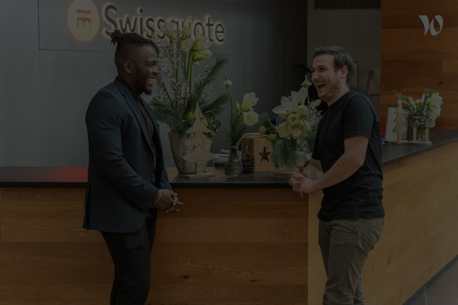
Strategy#1
Make the invisible visible
Today @
Strategy #1 - Make the invisible visible

Slide 21
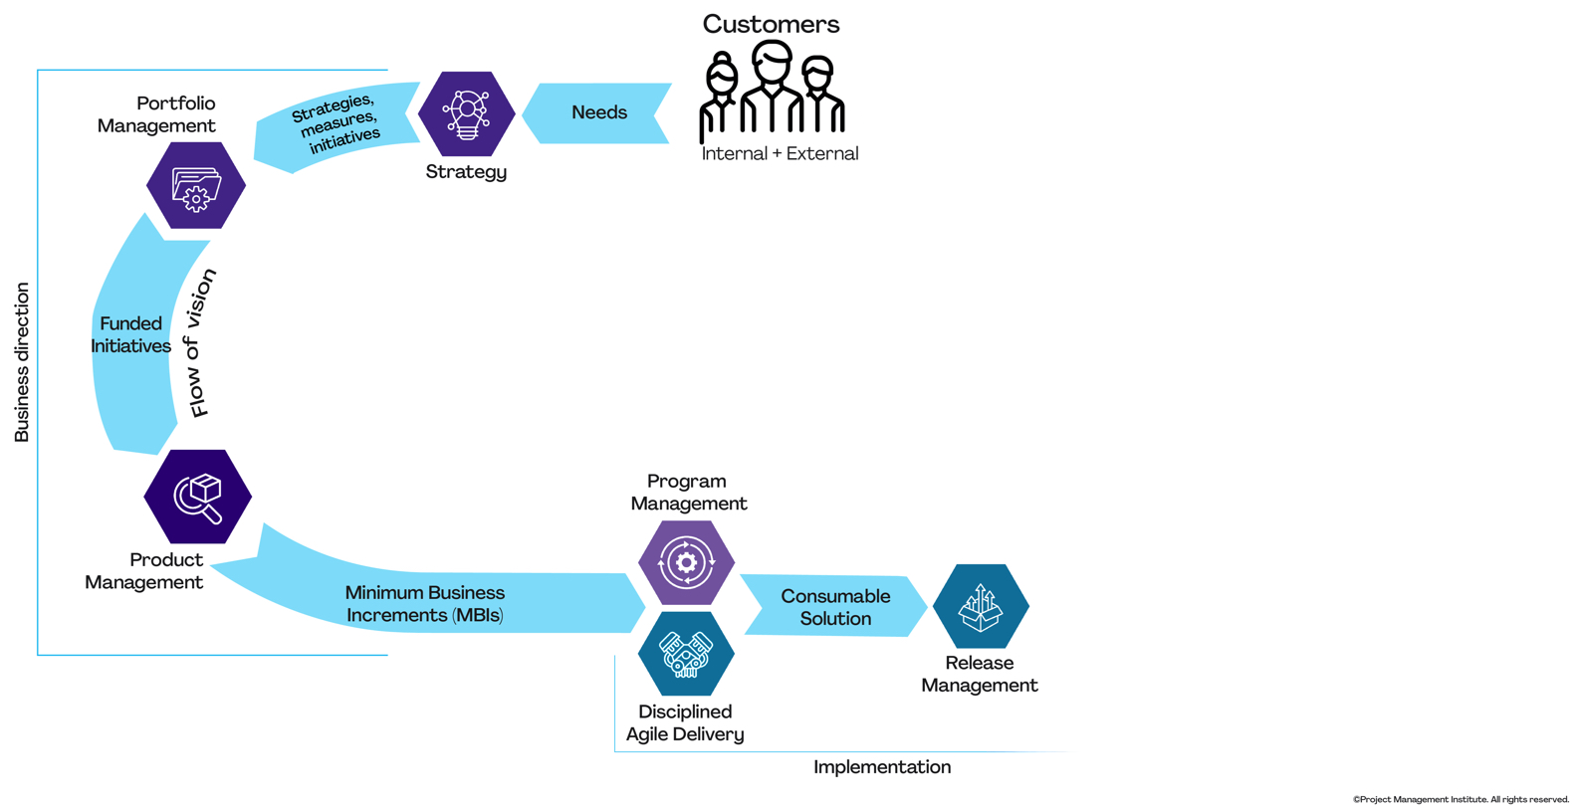
Strategy #1 - Make the invisible visible

Slide 22




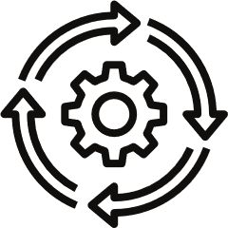


Organization V4
Product Strategy
Solution Conception
Implementation
1
xxx
1
xxx
1
xxx
1
Initiation
1
Project Scoping
2
Agreement & Planning
3
Inception
4
Construction
5
Transition
Groundwork
Components
Decision
Preparation
Action
Deployment
Time to market
Strategy #1 - Make the invisible visible

Slide 23


Organization V4
Implementation
3
Inception
4
Construction
5
Transition
Preparation
Action
Deployment
Tests detailed
Architecture Proved
Development
Grooming
Retrospective
Estimation
Tests
Planning
Roll
out
Demo
Production Ready
Strategy #1 - Make the invisible visible

Slide 24

Keytakeway #1
Make the invisible visible
Value Stream Concept
Strategy #1 - Make the invisible visible

Slide 25
Strategy #2
Identify your
battles
Unperceived complexity

Slide 26
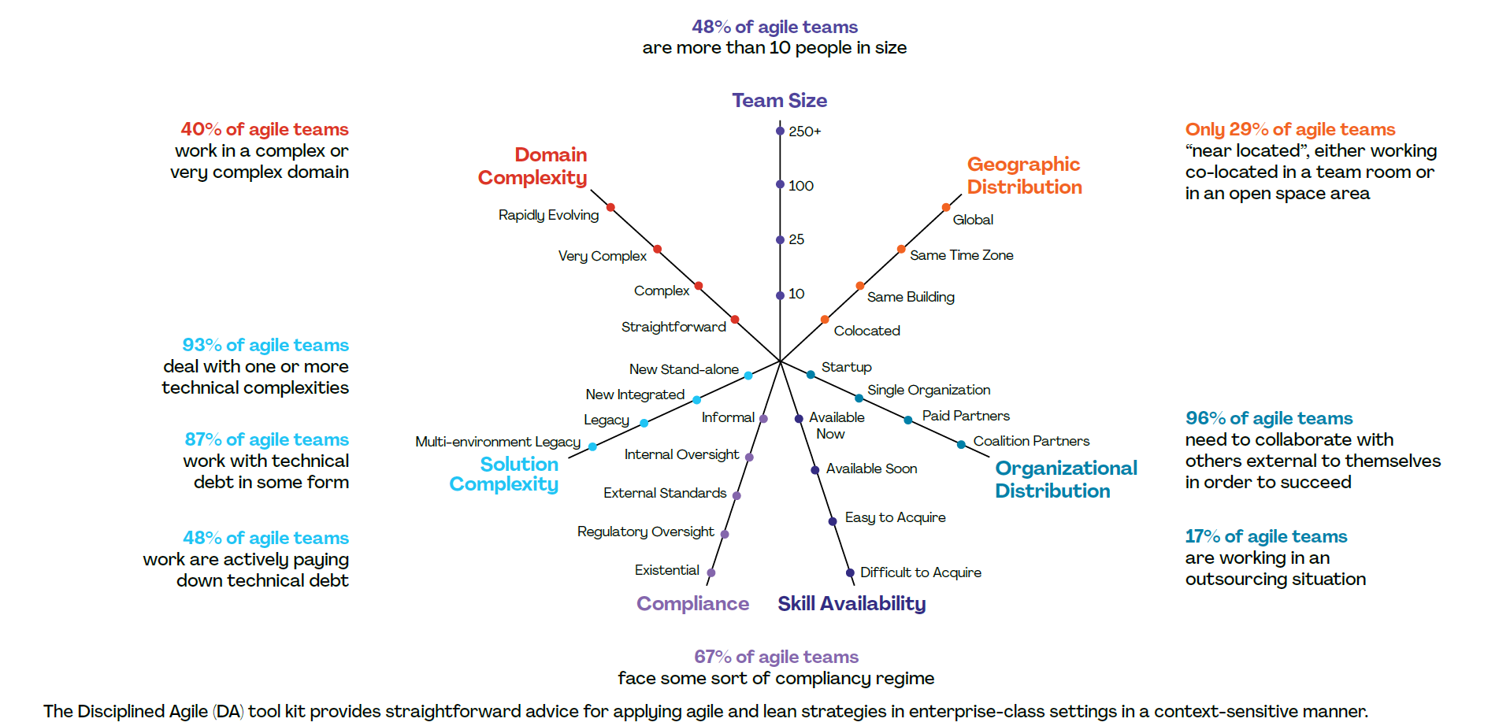

Tactical
Scaling
Tool
Strategy #2 - Identify your Battles

Slide 27
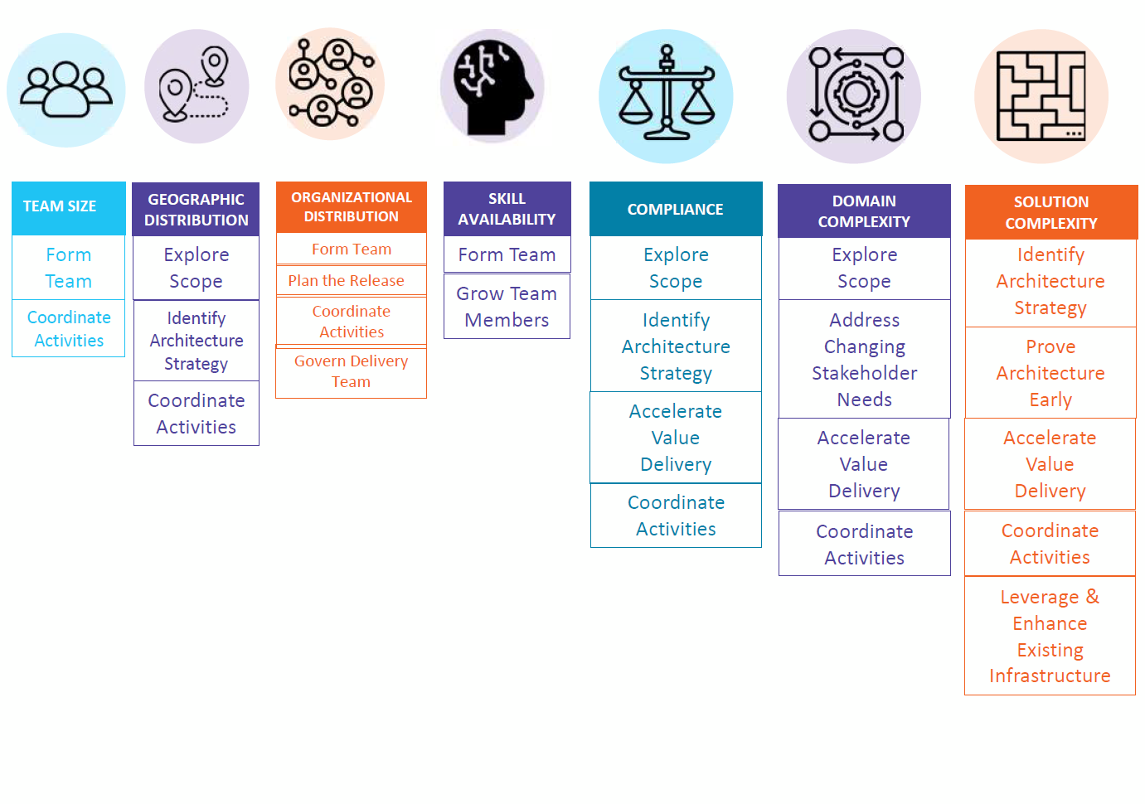
24 Process goals
to select the best strategy
Strategy #2 - Identify your Battles

Slide 28
Furthest points
good starting points to align
Strategy #2 - Identify your Battles

Slide 29
Strategy #2 - Identify your Battles

Slide 30

Let’s focus on solution complexity
What could have helped Sophie?
Strategy #2 - Identify your Battles

Slide 31
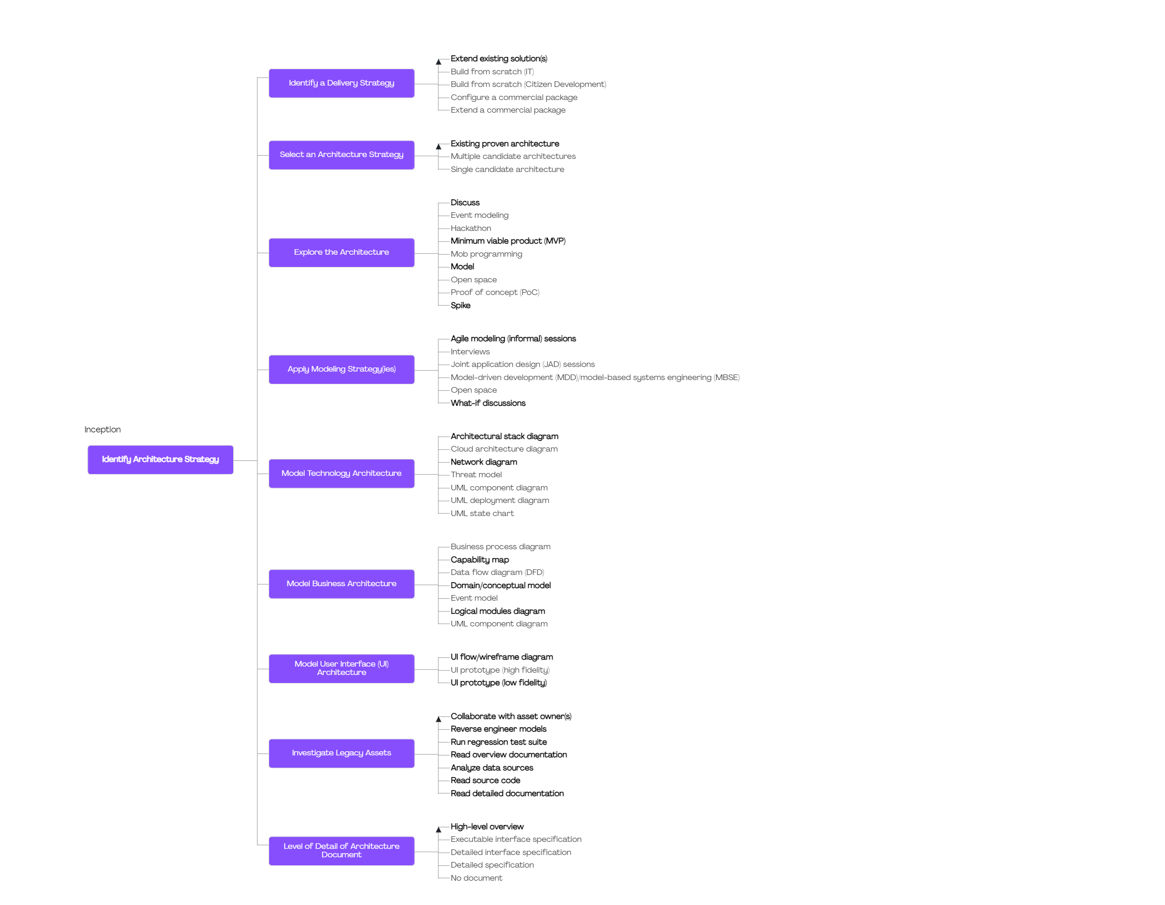
Strategy #2 - Identify your Battles

Slide 32
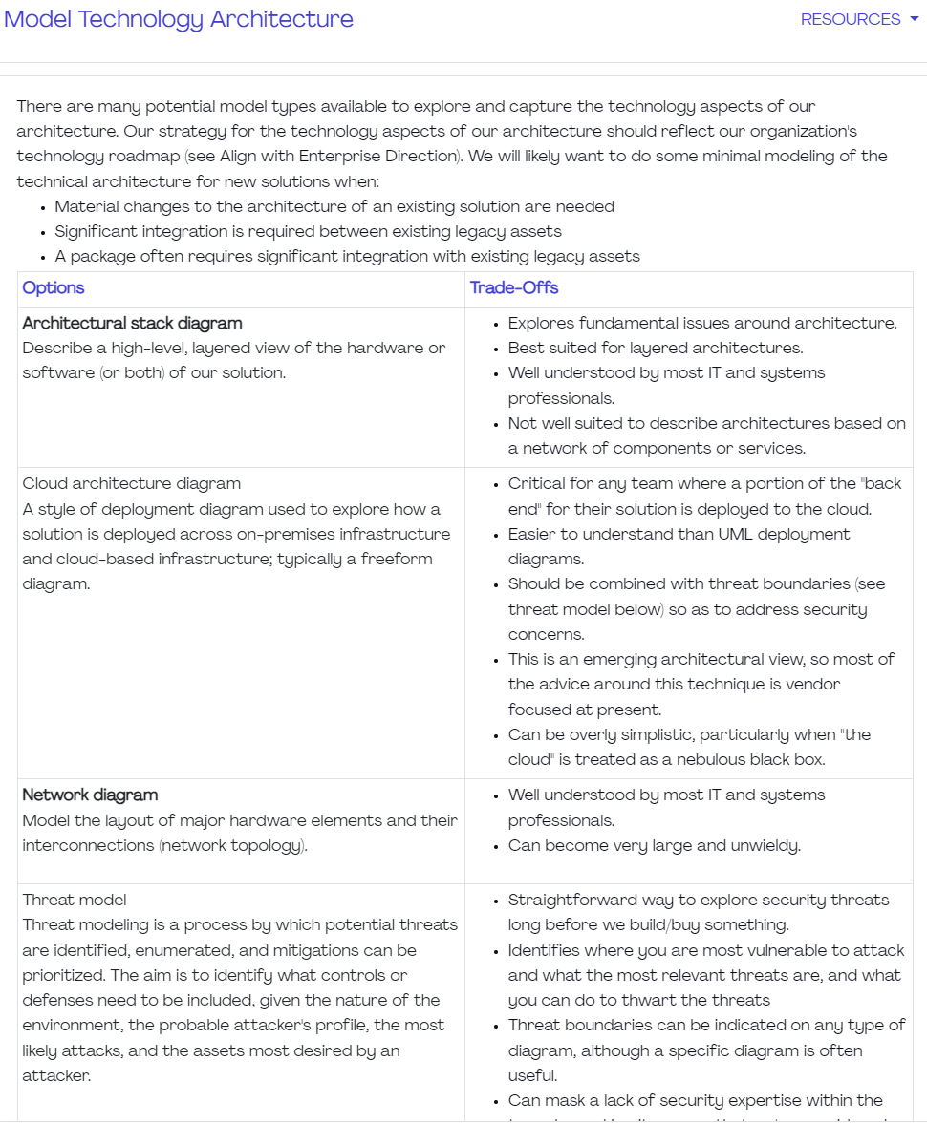
Model Business Architecture > Architectural stack diagram
Strategy #2 - Identify your Battles

Slide 33
Domain Complexity
Explore Scope
Elicitation and capture of the initial requirements for our solution.
Address Changing Stakeholder Needs
Collaboration with stakeholders and adaptation to changing needs.
Accelerate Value Delivery
Optimization of how our team works (work organization, deployment, QA)
Coordinate Activities
Coordination both within a team and with other teams within our organization.
Strategy #2 - Identify your Battles

Slide 34

Let’s focus vote together on the Process Goals to focus on!
Strategy #2 - Identify your Battles

Slide 35
Domain Complexity
Explore Scope
Elicitation and capture of the initial requirements for our solution.
Address Changing Stakeholder Needs
Collaboration with stakeholders and adaptation to changing needs.
Accelerate Value Delivery
Optimization of how our team works (work organization, deployment, QA)
Coordinate Activities
Coordination both within a team and with other teams within our organization.
Strategy #2 - Identify your Battles

Slide 36

Let's experiment the DA Browser!
1
Take your phone
2
Scan the QR Code
3
Explore the DA Browser
Strategy #2 - Identify your Battles

Slide 37
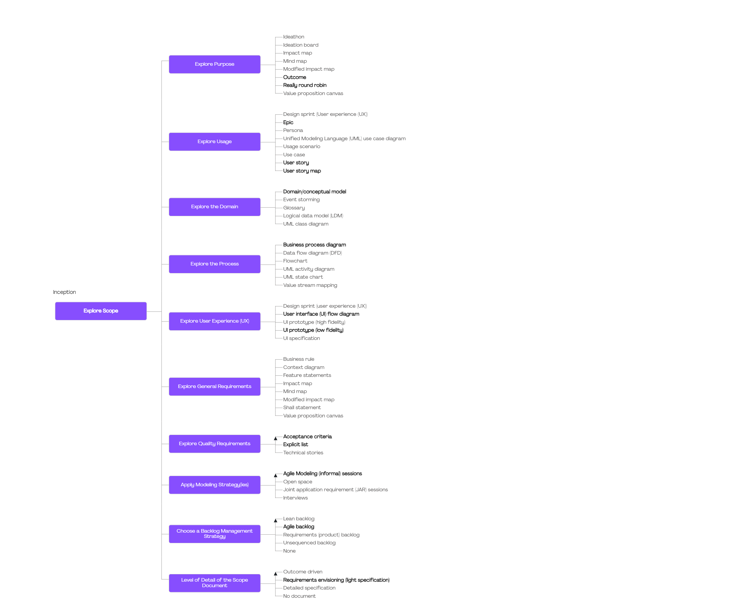
Strategy #2 - Identify your Battles

Slide 38
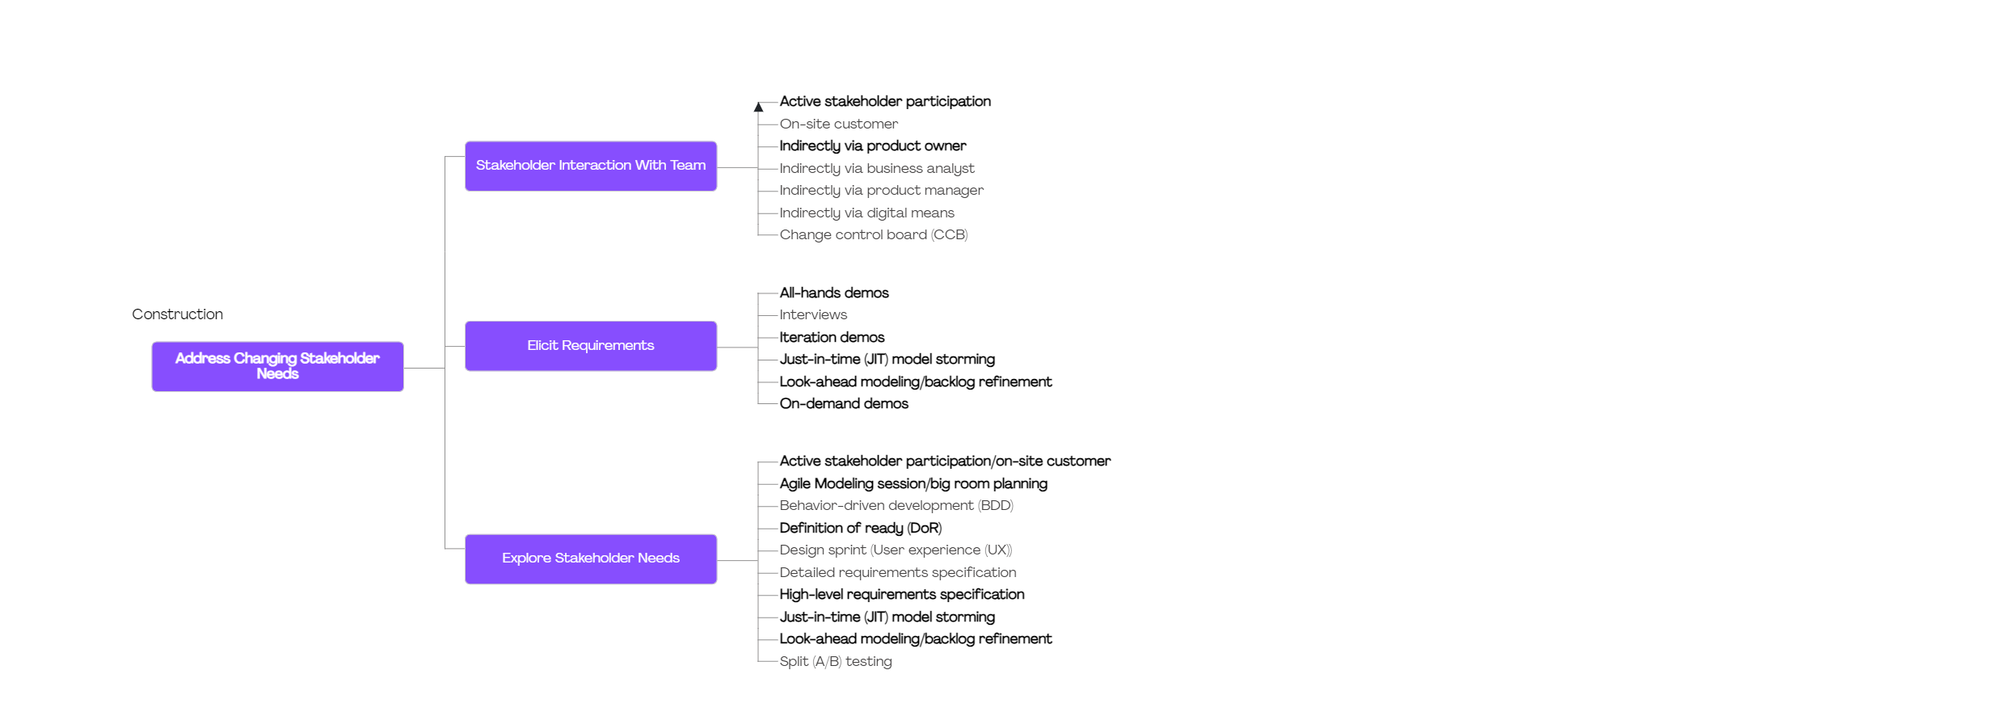
Strategy #2 - Identify your Battles

Slide 39
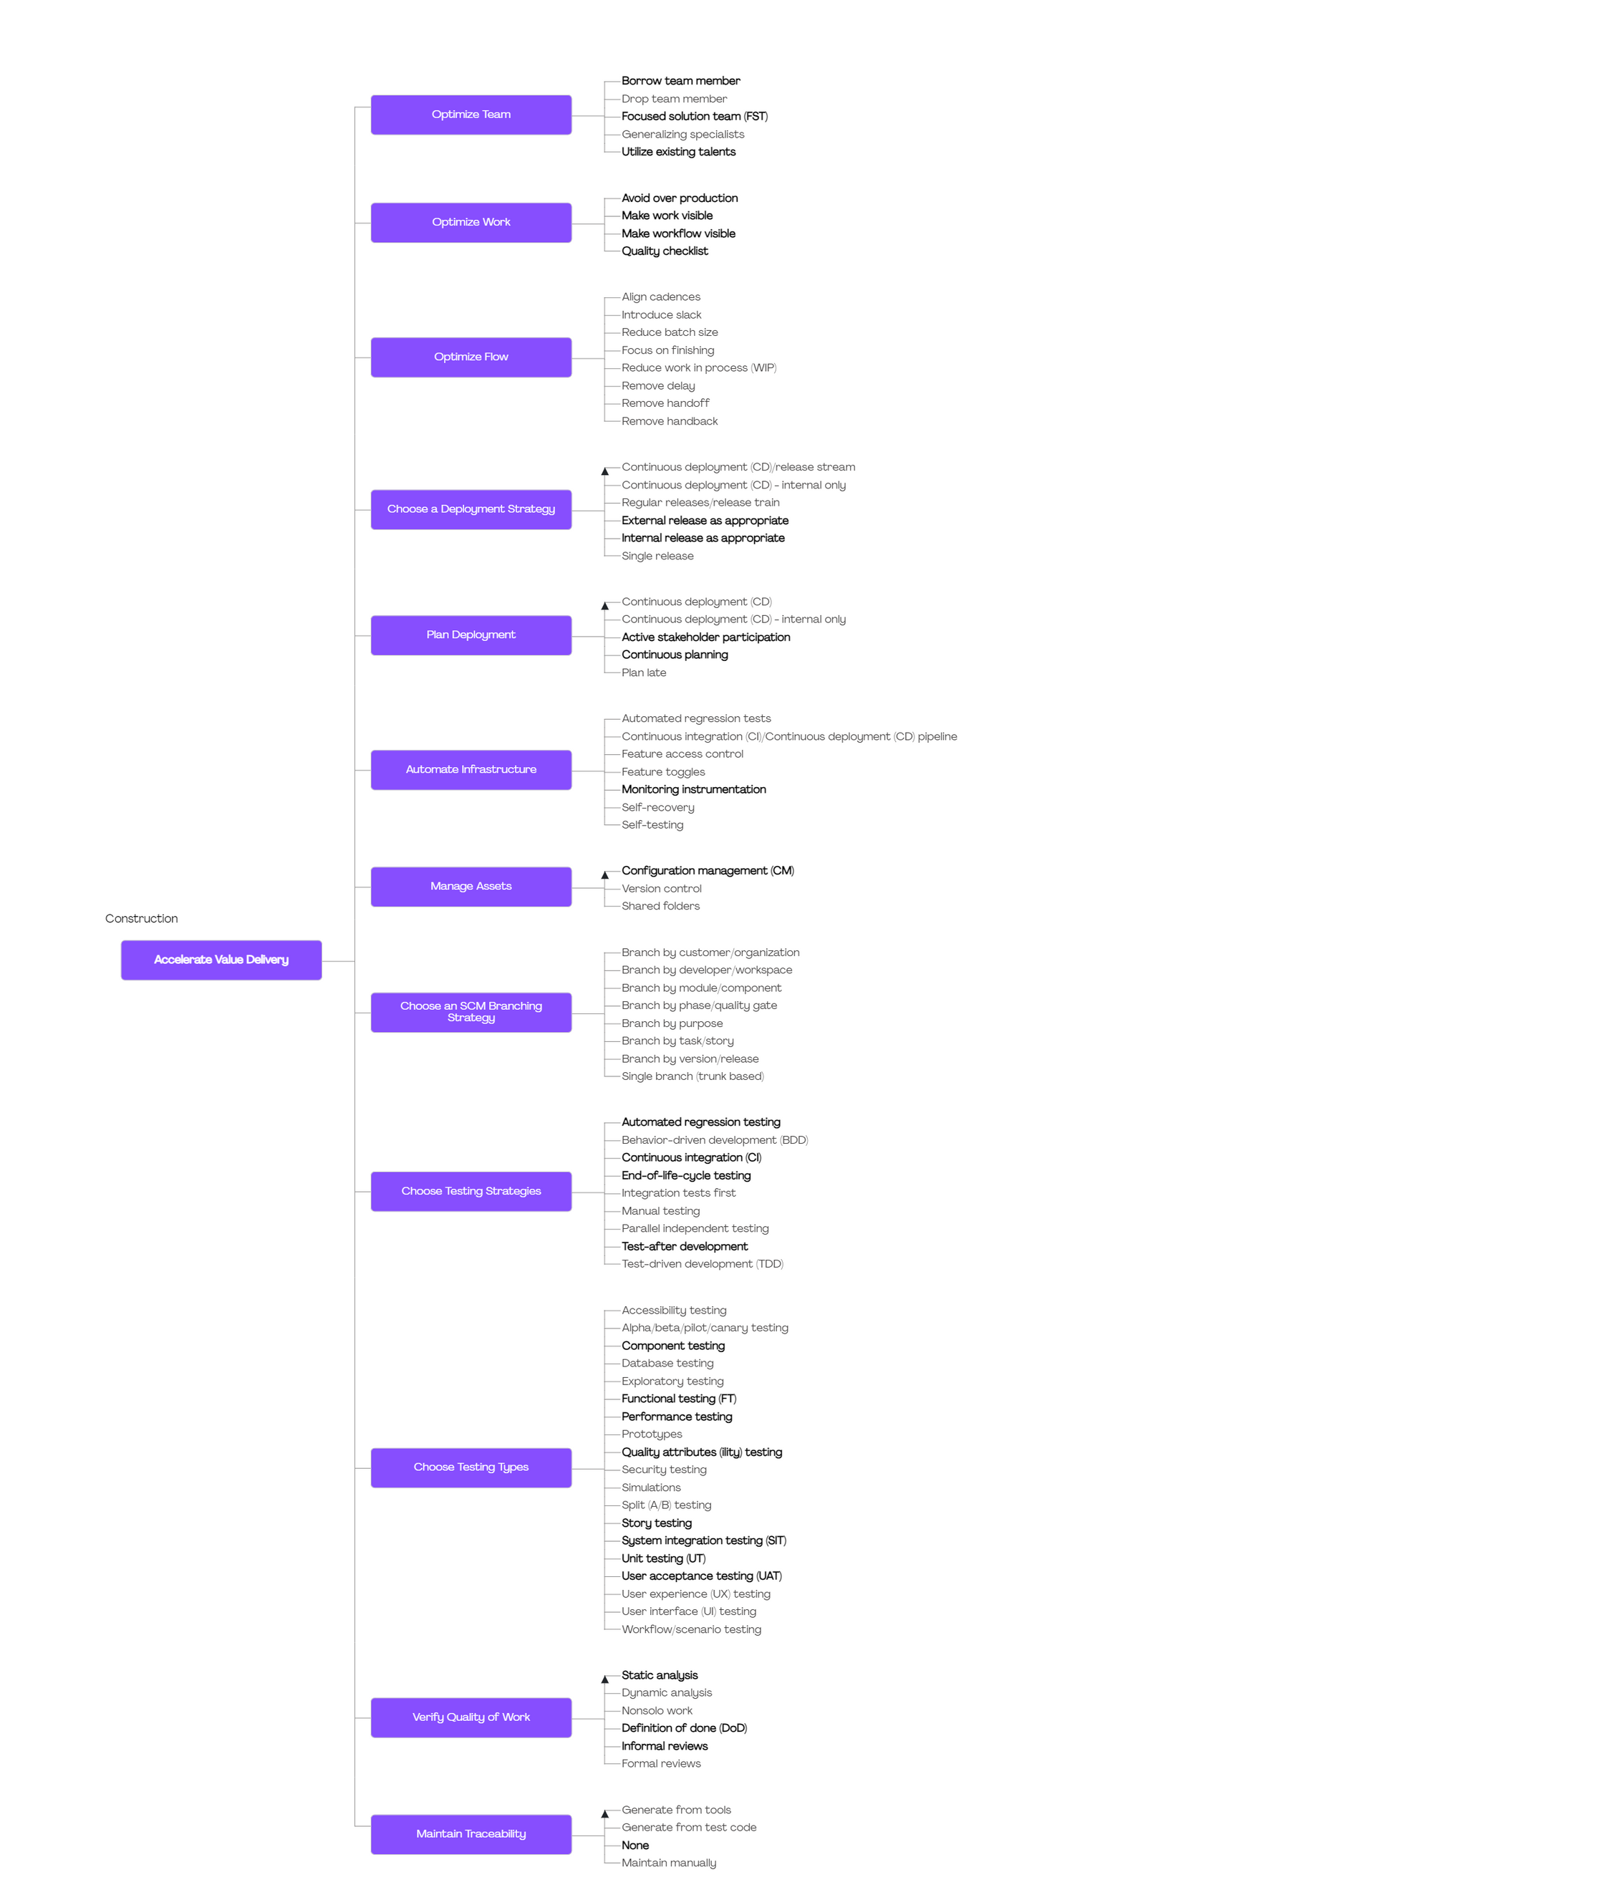
Strategy #2 - Identify your Battles

Slide 40
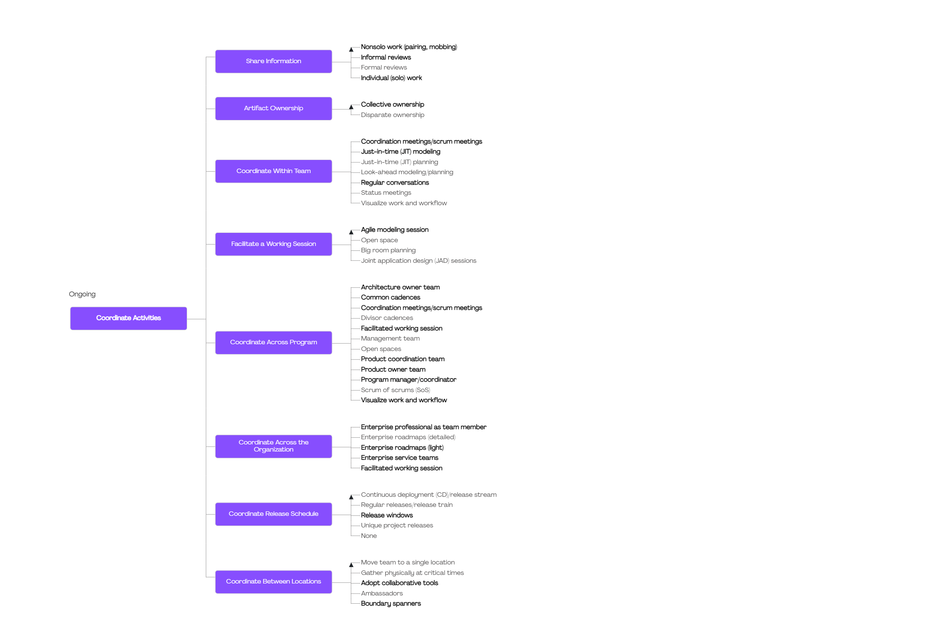
Strategy #2 - Identify your Battles

Slide 41
Benefits
Alignment on methodologies
#1
Tactical and Intentional in practices choices
#2
Guidance and documentation for Team
#3
Strategy #2 - Identify your Battles

Slide 42

Strategy#2
Identify your Battles for success
Today @
Strategy #2 - Identify your Battles

Slide 43
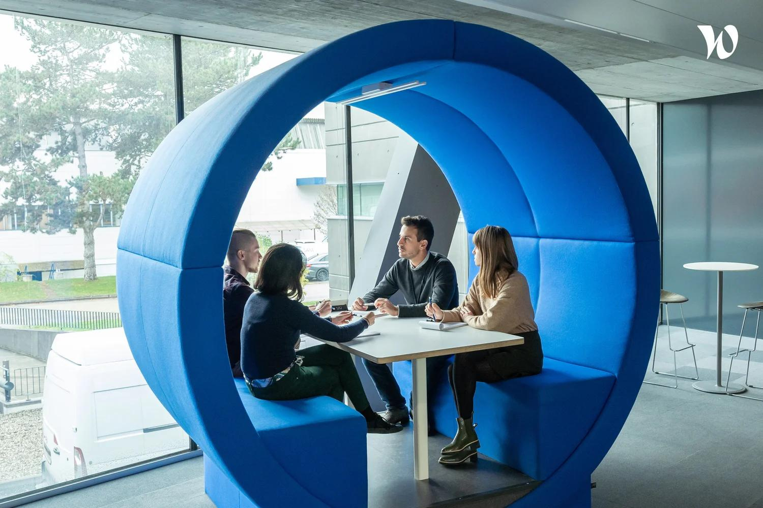
Financial Data Team Context
#1
Multiples stakeholders and requests
Complexity and misalignment in term of request
#2
#3
Prioritization issues
Strategy #2 - Identify your Battles
Notes:
Fin Data
Prioritization issue

Slide 44
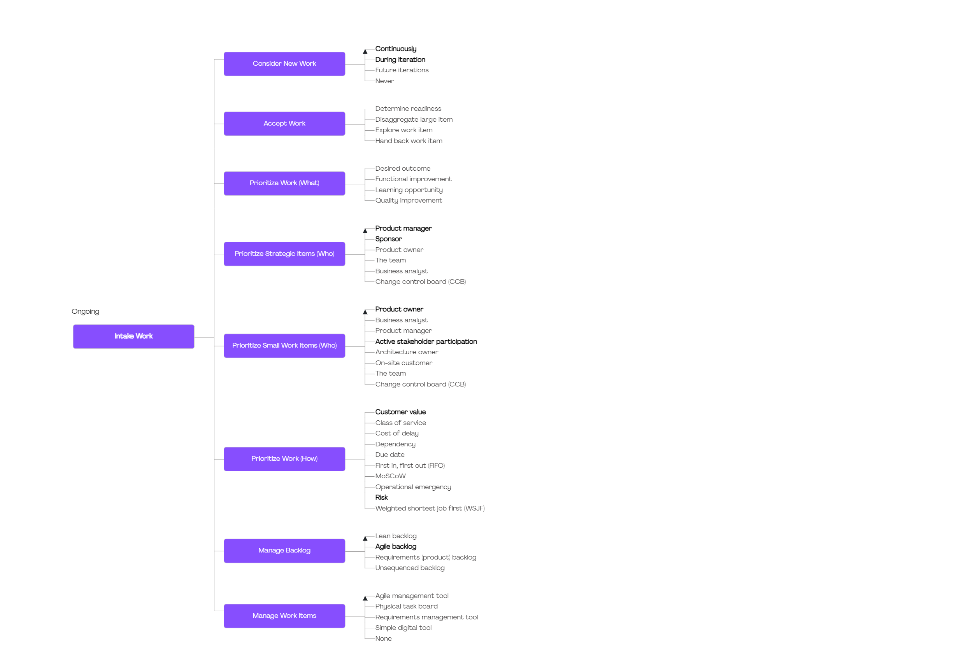
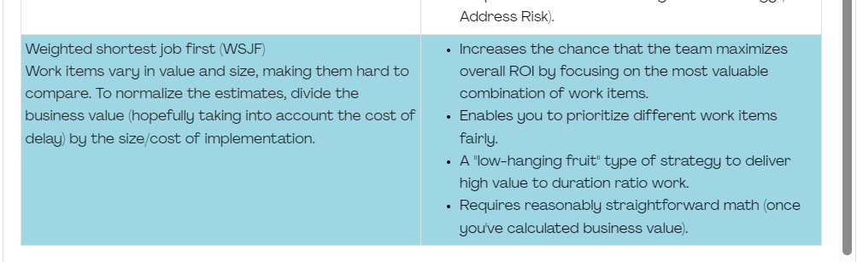
What does DA Browser propose for prioritization?
Strategy #2 - Identify your Battles

Slide 45
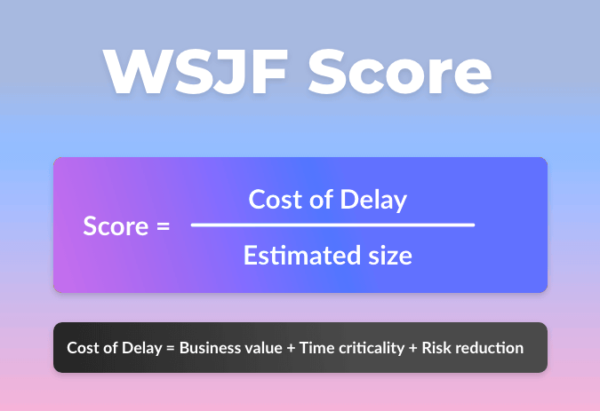

WSJF (Weighted shortest job first)
Cost of Delay
Job Size
Strategy #2 - Identify your Battles

Slide 46

Keytakeway #2
Identify your battles for success
Tactical Scaling & DA Toolbox
Strategy #2 - Identify your Battles

Slide 47
Strategy #3
Cultivate Continuous improvement
No knowledge based
Strategy #3 - Cultivate continuous improvement

Slide 48

Knowledge
Guidance
Learning
CoE
CoP
Strategy #3 - Cultivate continuous improvement

Slide 49
Benefits
#1
Coaching
#2
Guidelines
#3
Sharing knowledge
Strategy #3 - Cultivate continuous improvement

Slide 50

Strategy#3
Cultivate Continuous Improvement
Today @
Strategy #3 - Cultivate continuous improvement

Slide 51
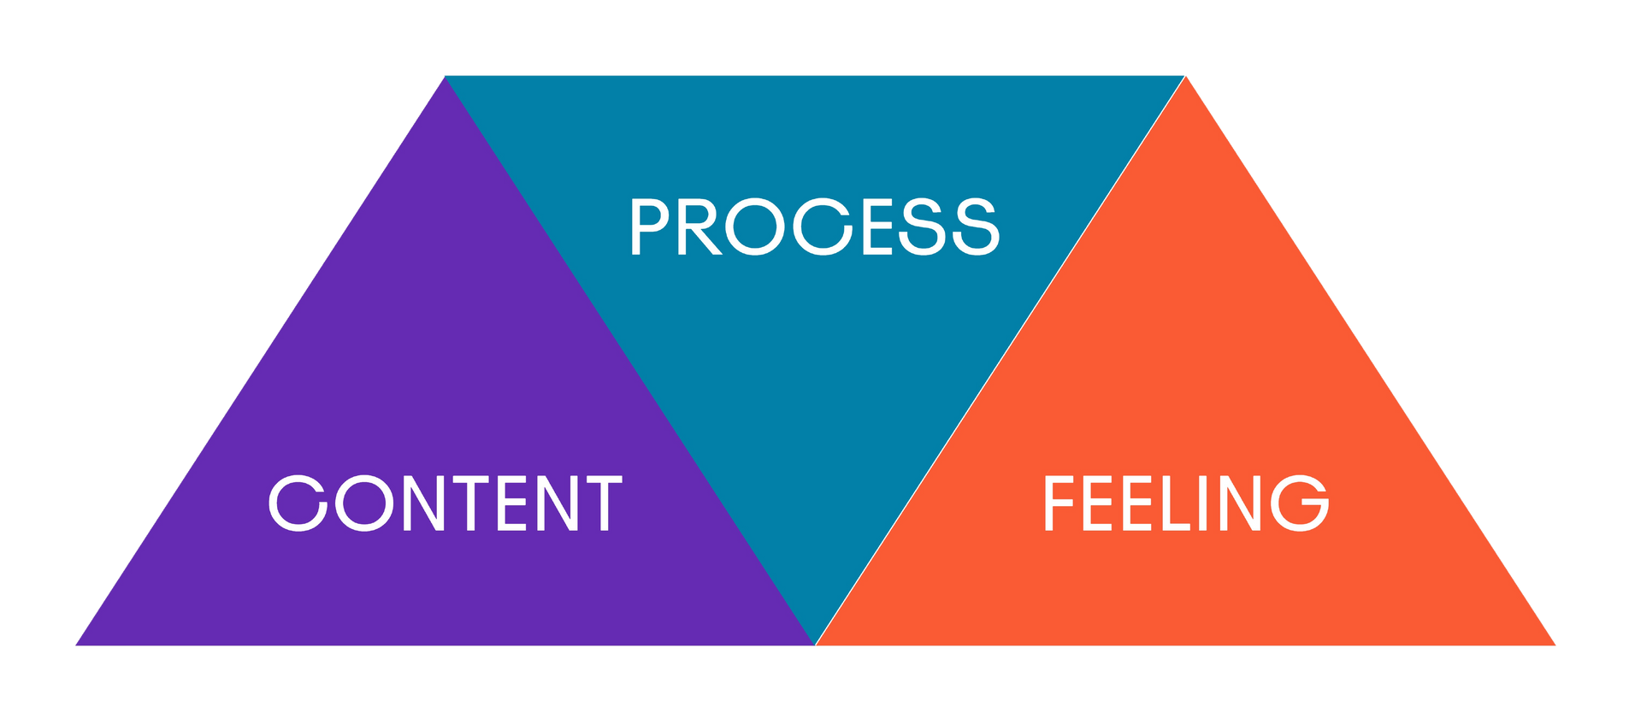
Center of Excellence
Coaching
Disciplined Agile
Psychological Safety
Strategy #3 - Cultivate continuous improvement

Slide 52
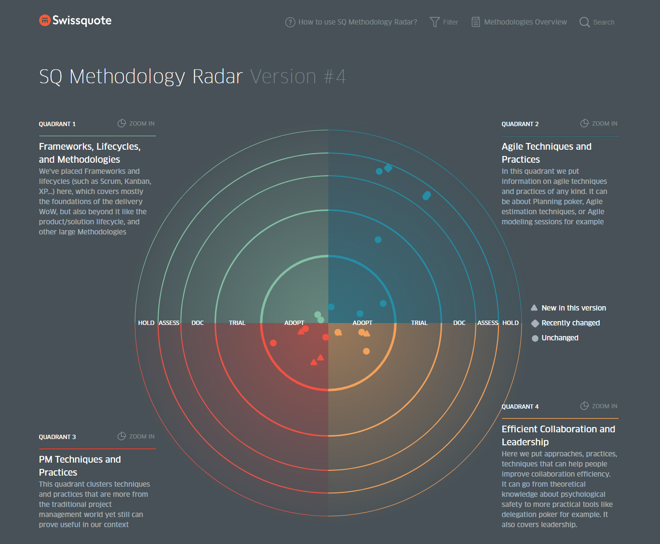
Methodology
Radar
Strategy #3 - Cultivate continuous improvement

Slide 53
Center of Excellence
Coaching
Disciplined Agile
Psychological Safety
Strategy #3 - Cultivate continuous improvement
Notes:
CoE is giving guidance, providing tools, practices and methods. They are coaching the managers, the program managers, the Product owners.
And another part the Center of Excellence is focusing on is the Feeling pillar. They are providing a safety place, promoting a Freethinking environment, where people can express themselves, bring ideas, debate and question the status quo.
CoE is fostering the 3 pillars Process, Content, Feeling.
Bringing guidance with Disciplined Agile.
Coaching teams, managers, program managers when they are facing issues. And ensuring the safety place.
And that's what they are advocating for within the communities. Ensuring the culture aspect in the CoP. psychological safety.
Process awareness
Knowledge base
Content
Feeling
Process

Slide 54
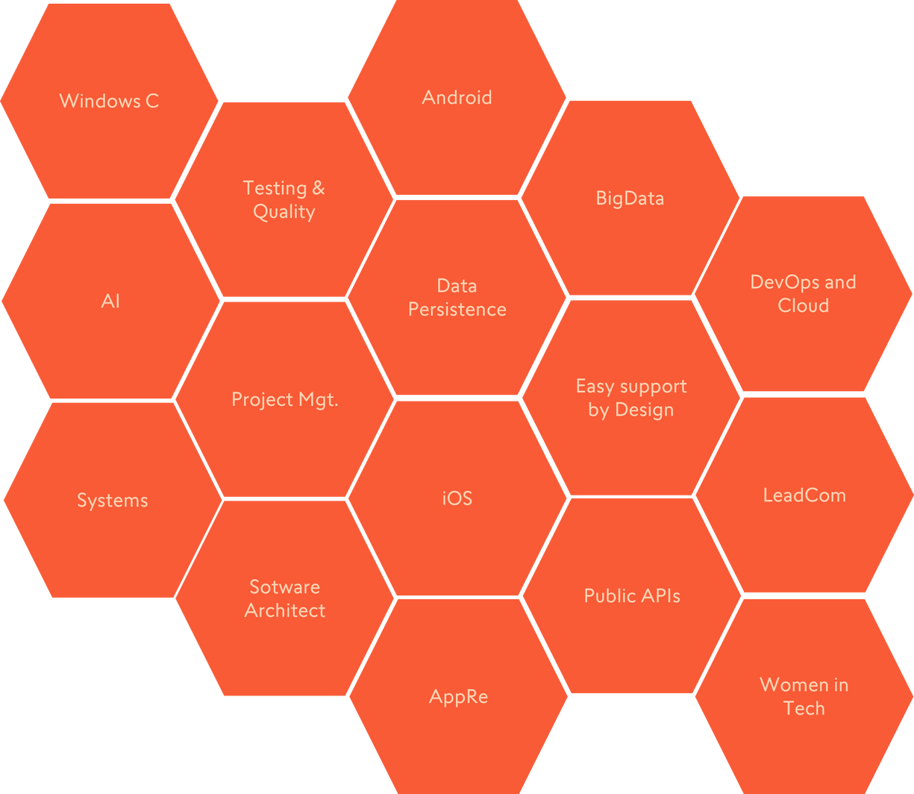
Communities of practices
Strategy #3 - Cultivate continuous improvement

Slide 55
Keytakeway #3
Cultivate continuous improvement
CoE & CoP
Strategy #3 - Cultivate continuous improvement
Notes:
La

Slide 56

A Secret about Sophie

Slide 57
Three Strategies for a successful workplace
Make the invisible visible
#1
> Value Stream
Identify your battles
#2
> Tactical Scaling + DA Brower
#3
Cultivate continuous improvement
> CoE + CoP

Slide 58
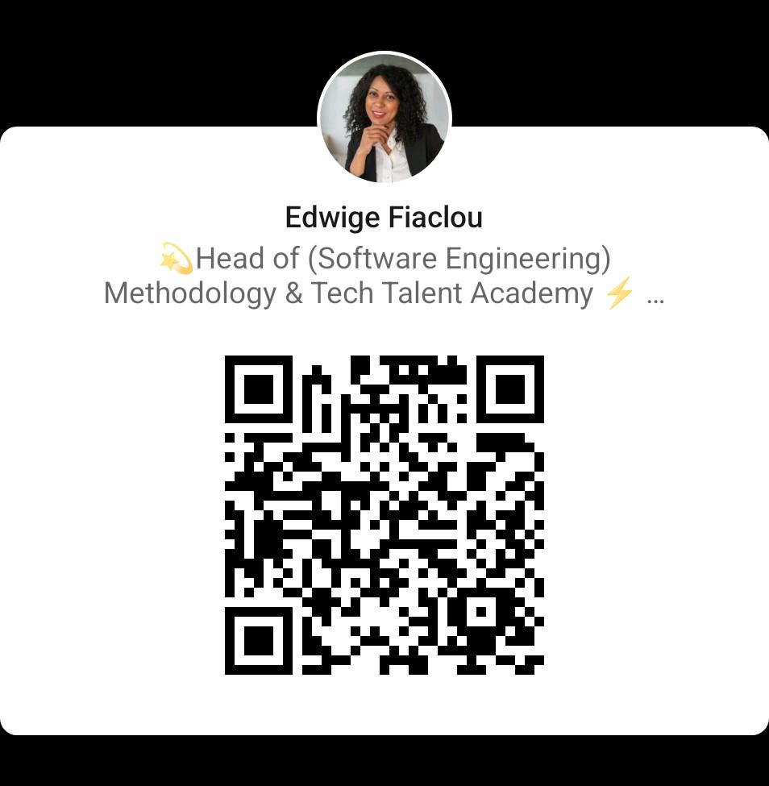
Stay in contact with me!
#SharingIsCaring

Slide 59
Thank you!
Do you have
any questions?

